Slide 1

Mini Project (KCA353) Odd Semester Session 2024-25
SAATHI
Jatin Gupta(2300290140080)
Ayushi Verma(2300290140047)
Lalit Sharma(2300290140096)
Project Supervisor:
Mr. Prashant Agrawal

Slide 2


Saathi
Bridging the gaps in student life
Saathi is a student-centric rental platform developed with
Java Servlet, designed to help students save money and earn
by renting out items they no longer need. The platform caters
specifically to the unique financial needs of students by offering
a cost-effective solution, providing access to a wide range of
rentable goods, including textbooks, electronics, furniture, and more,
making essential items both affordable and accessible..

Slide 3


Introduction
1
Student-Centric Rental Platform
2
Financial Burden Reduction
For college students to rent items from peers.
Reduce the cost of buying new items.
3
Sustainability
4
Modern Technology
Promote resource sharing and reduce waste.
Built with the latest technology for efficiency.

Slide 4
Literature Review
1
2
OLX: Peer-to-Peer Marketplace Model
Cashify: Focused on Tech Devices and Refurbishment
OLX uses a peer-to-peer (P2P) model, allowing users to list and sell items directly to others. Sellers can post images, descriptions, and prices, while buyers browse, contact sellers, and negotiate. Its success relies on a user-friendly interface and broad categorization, covering electronics, vehicles, and real estate.
Literature Findings: The P2P model promotes community and trust, key for high-value item exchanges. OLX enhances trust through user ratings and reviews but faces challenges with item authenticity and fraud prevention, requiring consistent monitoring and user education.
Cashify specializes in the purchase and resale of electronic devices, particularly smartphones. The company follows a "buyback" model, where users can sell their old phones to Cashify directly. The platform then refurbishes these items and resells them. Cashify’s process includes device inspection, evaluation, and pricing based on the condition and brand of the product.
Literature Findings: Aligned with circular economy principles, Cashify reduces e-waste and appeals to eco-conscious buyers seeking affordable devices. Its convenience features, like home pick-up and instant payment, enhance user experience and attract time-conscious consumers.

Slide 5


Objective of the Project
Affordability
Convenience
Provide cost-effective rental options.
Easy access to items for students.
Sustainability
Promote resource sharing and reduce waste.

Slide 6

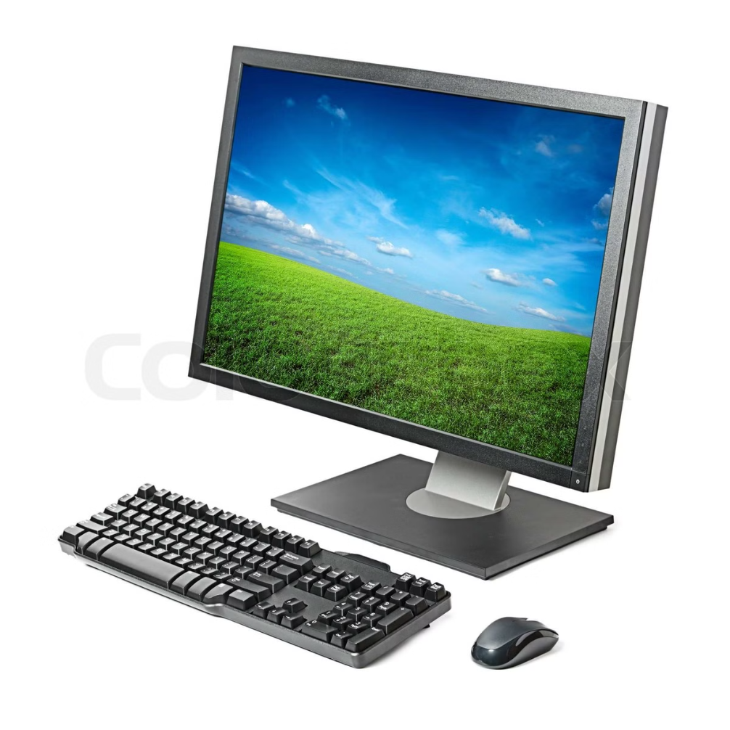
Hardware Requirements
Development Environment
Intel Core i3, 4GB RAM, 1TB HDD
Server Requirement
High Availability Cloud Servers
Client Requirement
Any device with internet access and a web browser

Slide 7
Software Requirements
Frontend
Backend
Tools
HTML, CSS, Basic JavaScript
Bootstrap
Java Servlet, JDBC, MySQL
NetBeans, Figma, etc.

Slide 8





Modules
User Registration/Login
Secure account creation and access.
Item Listing and Search
Browse and find available items.
Interactive Map Integration
Safe and reliable payment processing.
Secure Payments and Transaction System
Locate items on a map.
Admin Panel for Moderation
Manage platform content and users.
.
.

Slide 9
Workflow
User Registers/Logs in
1
Create or access an account.
2
User Browses Listings
Find items to rent.
Payments Processed
3
Securely complete transactions.
4
Items Delivered/Picked Up
Receive or return rented items.
Return Process and Feedback
5
Complete the rental cycle and provide feedback.

Slide 10




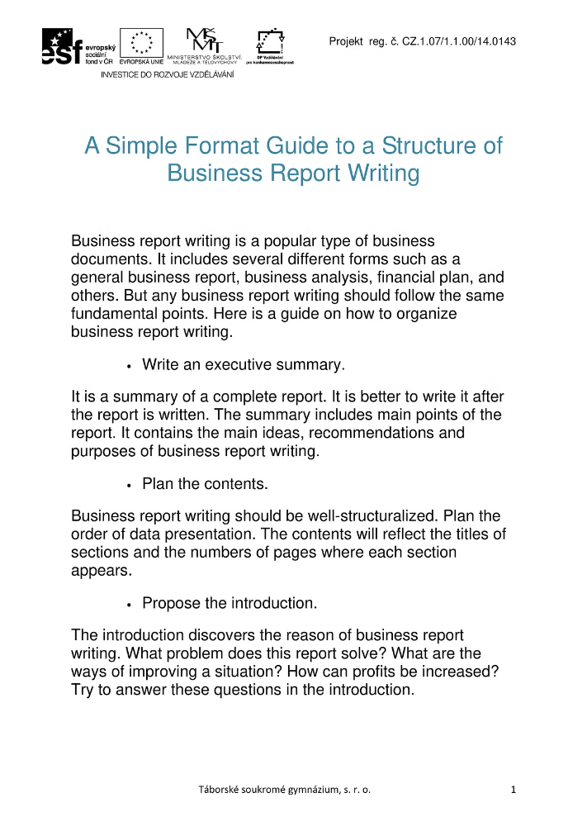


Reports
Student Rental History
Item Availability
Track past rental activity.
View available items for rent.
Financial Reports
Student Feedback and Reviews
Track transactions and income.
Analyze user feedback and ratings.

Slide 11



References
1
Java Servlet Documentation
2
Bootstrap Documentation
Official documentation for Java Servlet technology.
Documentation for the Bootstrap framework.
3
Javatpoint, TutorialsPoint
4
W3Schools
Online resource for web development tutorials.
Online resources for Java and web development tutorials.

